Slide 1





MAKE API DOCMENTATION USING .NET CORE

Slide 2




AGENDA
01
02
03
What is API Doc?
How to Implement it?
Where can I see it?

Slide 3

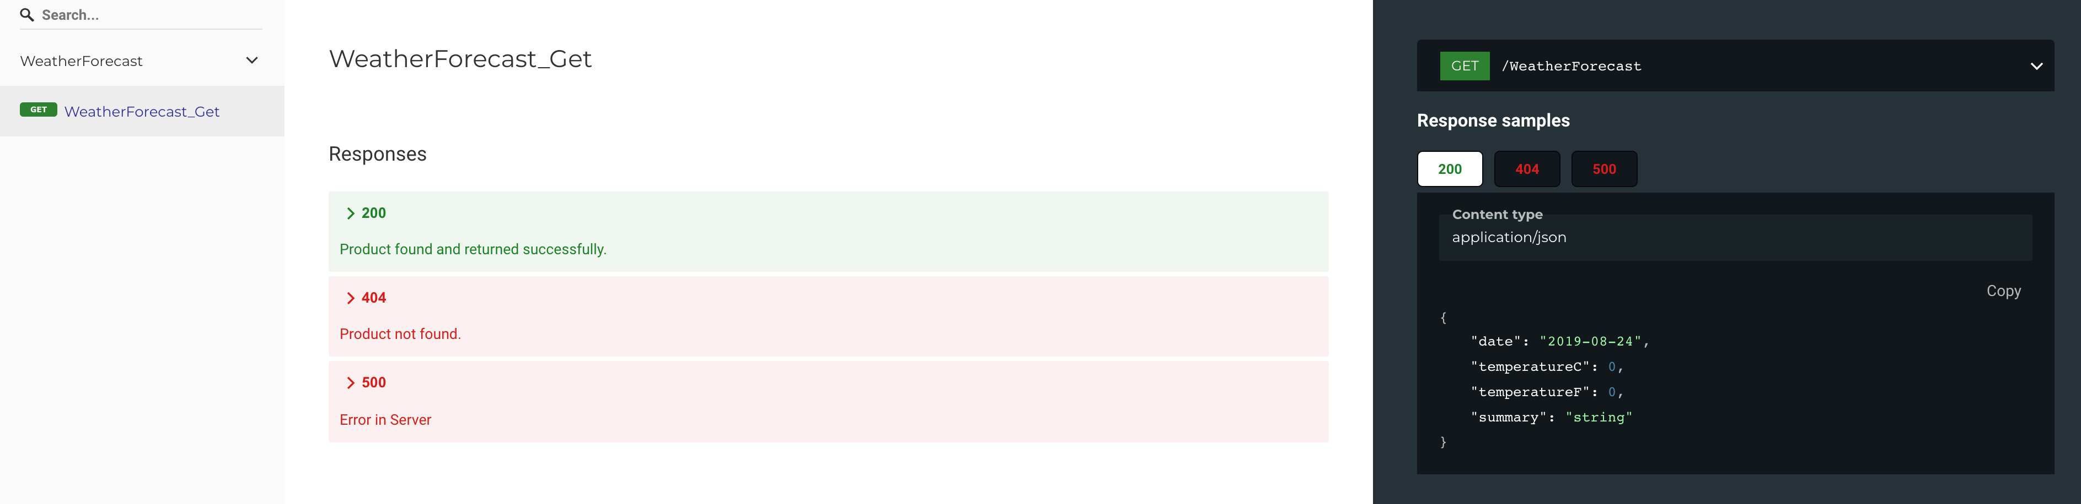
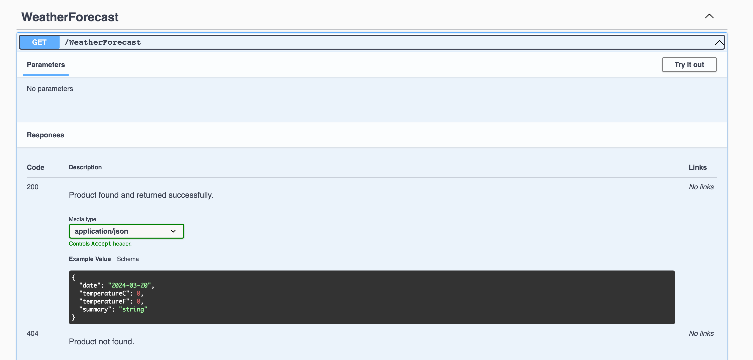
WHAT IS API DOC?
DEFINITION
API documentation is a comprehensive manual that contains instructions on how to effectively use and integrate with an Application Programming Interface (API).
PURPOSE
Ease of Use
Developer Support

Slide 4





HOW TO IMPLEMENT IT?
01
02
03
Install Packages
NSwag.Annotations
NSwag.AspNetCore
Add some code in file
Program.cs
Implement annotations in the
Controller and in each API call

Slide 5


HOW TO IMPLEMENT IT?
We’re going to explain it in VS Code

Slide 6
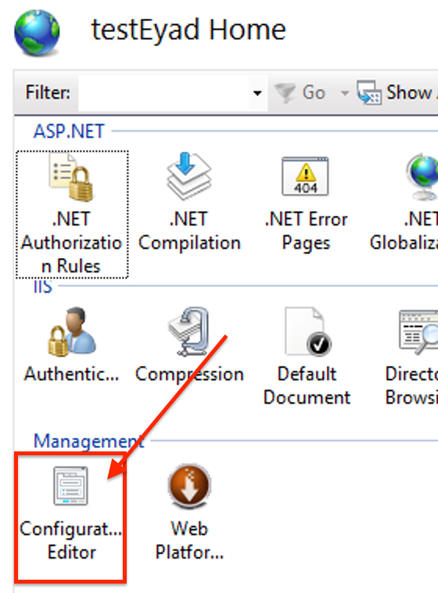
HOW TO IMPLEMENT IT?
You are going to open configuration editor
In IIS

Slide 7
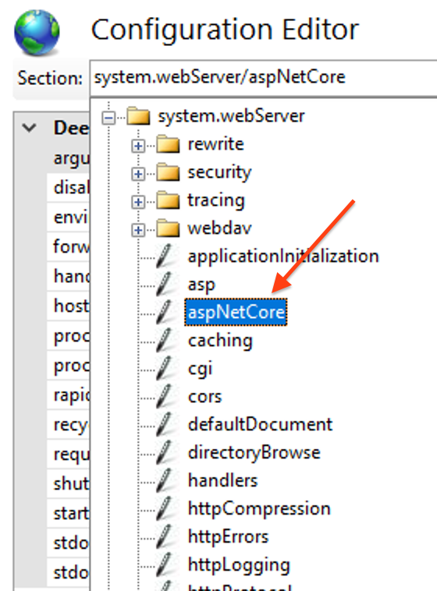
HOW TO IMPLEMENT IT?
Navigate to → system.webserver/aspNetCore

Slide 8
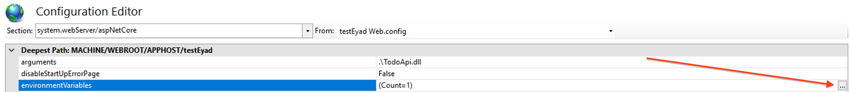
HOW TO IMPLEMENT IT?
Go to environmentVariables and open the box of …

Slide 9
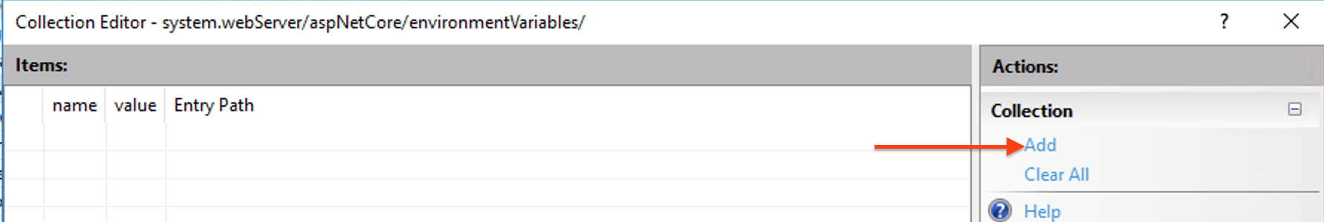
HOW TO IMPLEMENT IT?
Click Add

Slide 10
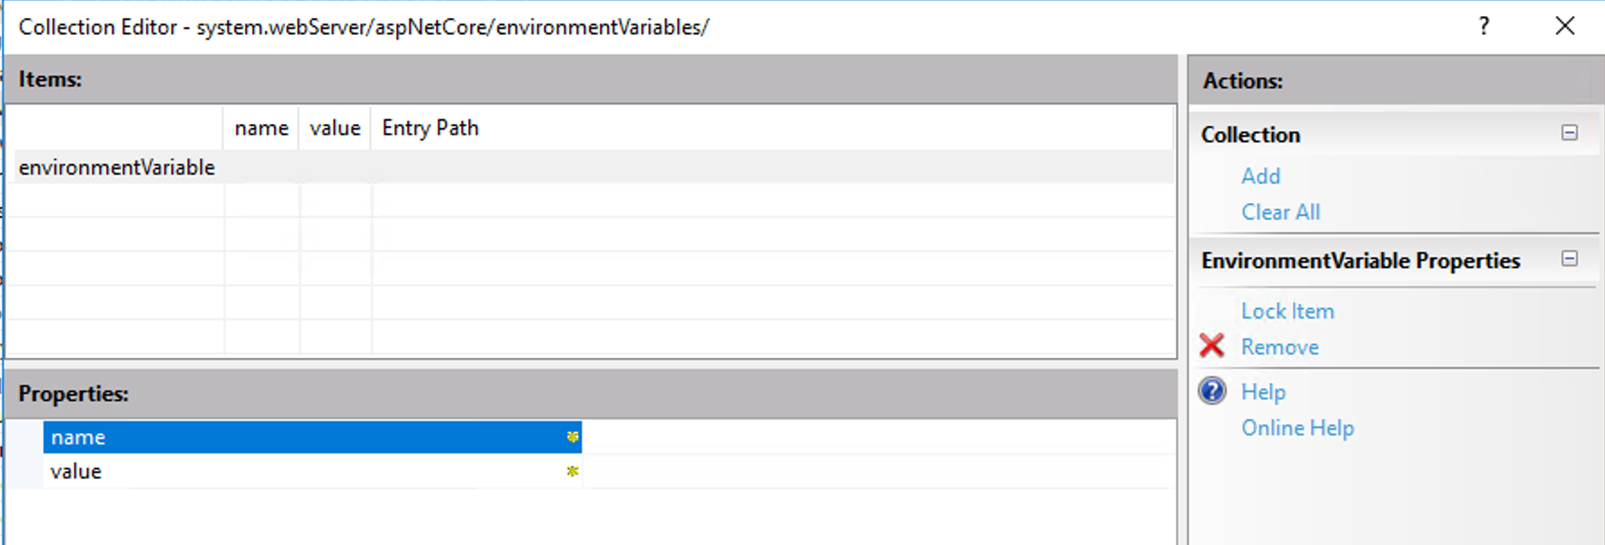
HOW TO IMPLEMENT IT?
Will going to add the properties following:
Name: ASPNETCORE_ENVIRONMENT
Value: Staging

Slide 11
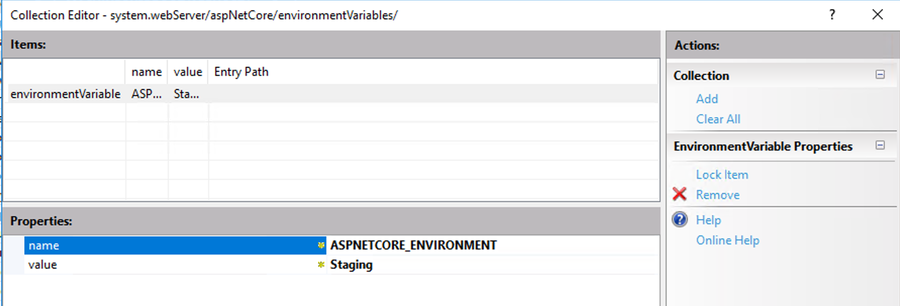
HOW TO IMPLEMENT IT?

Slide 12
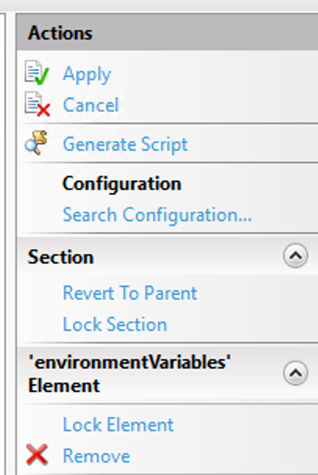
HOW TO IMPLEMENT IT?
Close it and then apply

Slide 13


Where can I see it?
By using this example URL:
http://localhost:5245/redoc/

Slide 14



THANK YOU

